Slide 1
Bank database USING BASH Script
Made by: Mariam Milad Amal Aly

Slide 2
agenda
Introduction
Whole Project Structure
Core Functionality
Advanced Functionality
Conclusion

Slide 3
Introduction
Objective
Key Features:
Improves Bash scripting and presentation skills.
Build a Bash script to manage client data (name, ID, accounts, funds, phone number)
Automates client data management.
Add, delete, update, search, and list clients.
Save database backups.
Core Functionality
Advanced Functionality

Slide 4
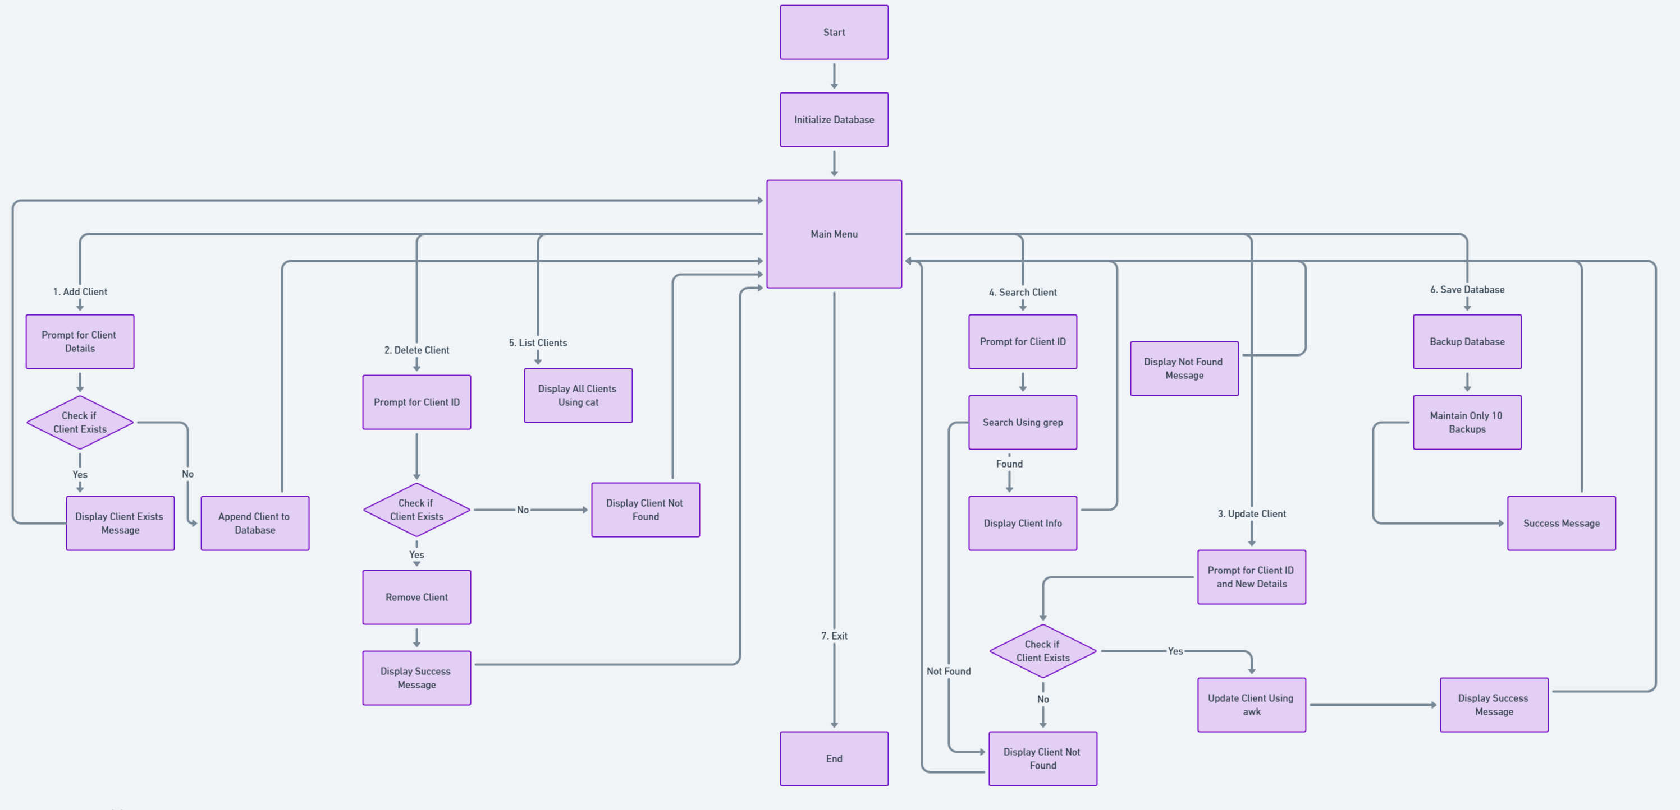
Whole Project Structure

Slide 5
Core Functionality
Database Initialization:
Create bank_database.txt if it doesn’t exist.
Add Client:
Prompt for client details and append to the database.
Delete Client:
Remove a client by ID using grep and temporary files.
Save Database:
Create a timestamped backup file

Slide 6
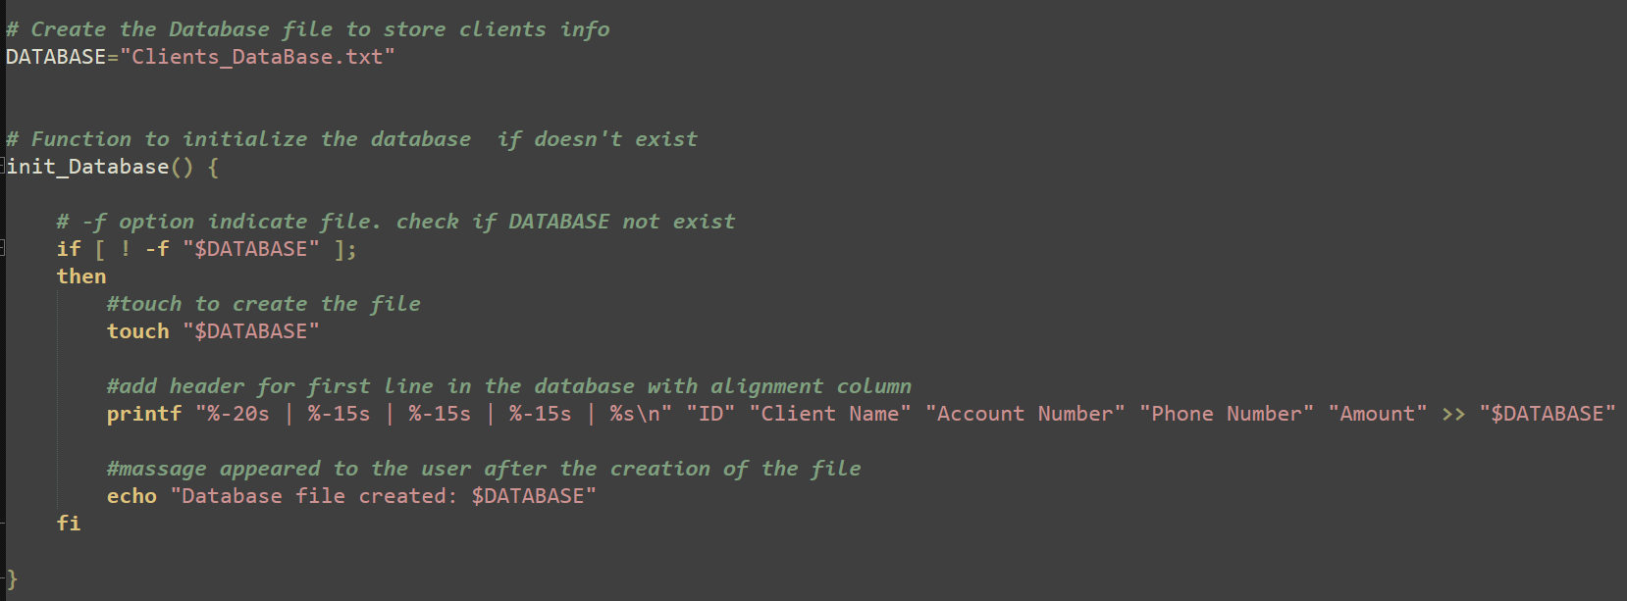
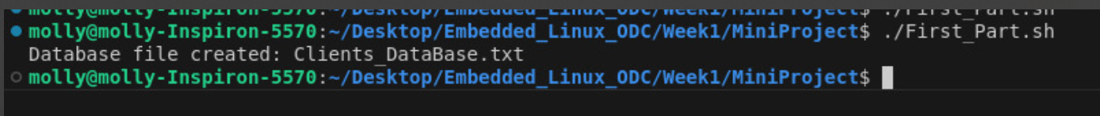
init_database
Code
Output

Slide 7
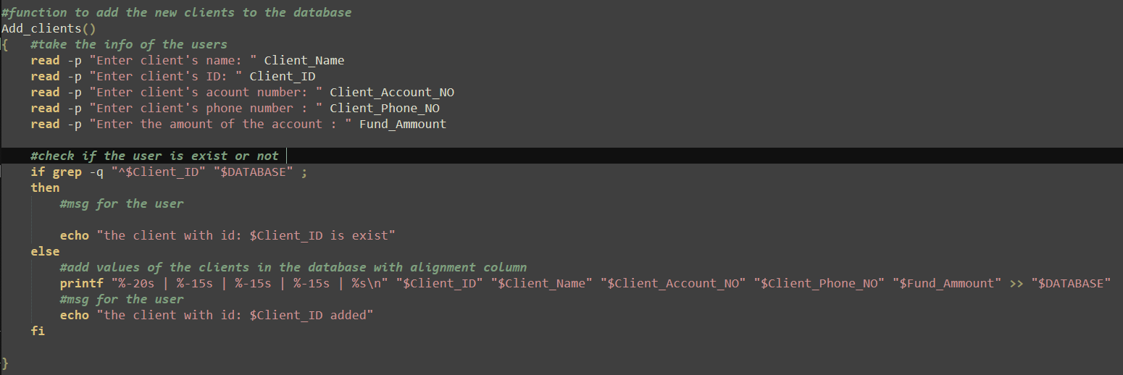
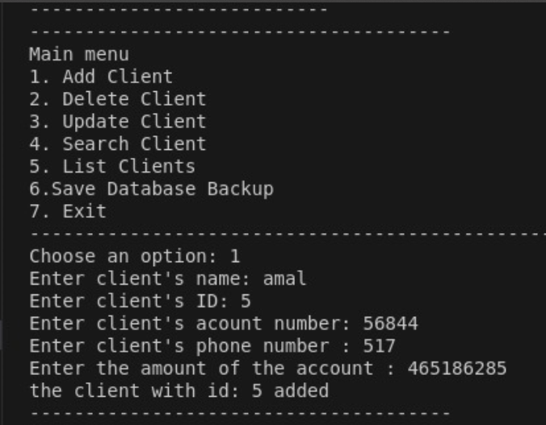
Add_clients
Code
Output

Slide 8
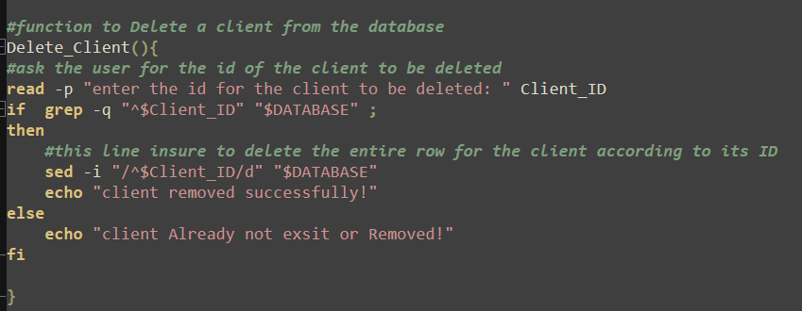
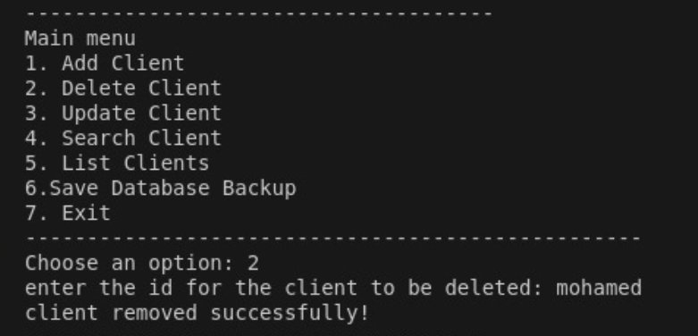
Delete_clients()
Code
Output

Slide 9
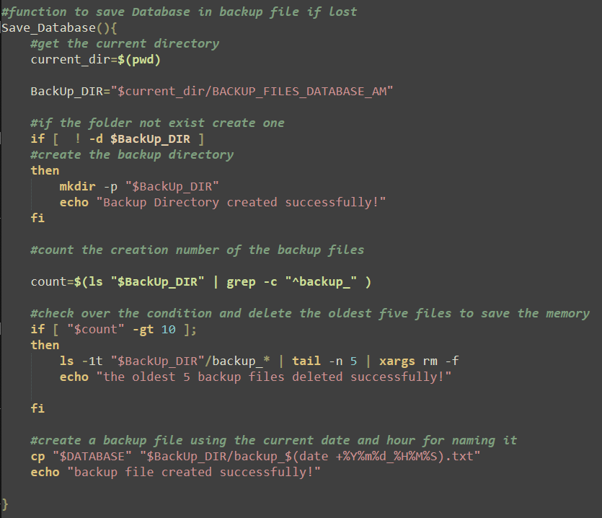
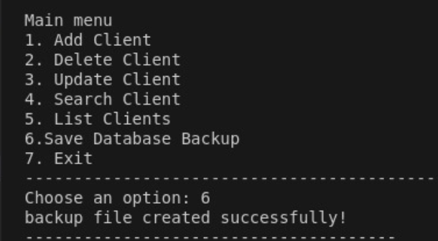
Save_database
Code
Output

Slide 10
Advanced Functionality
Update Client:
Modify client details using awk.
Search Client:
Find a client by ID using grep.
List Clients:
Display all clients using cat.
Main Menu:
Provide a user-friendly interface with a loop and case statement.

Slide 11
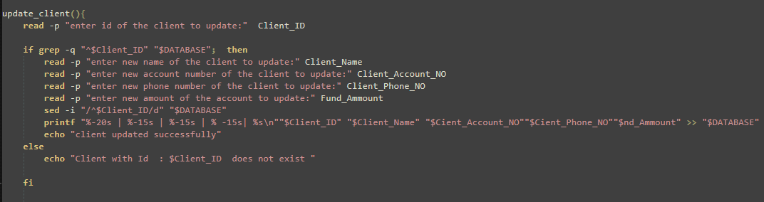
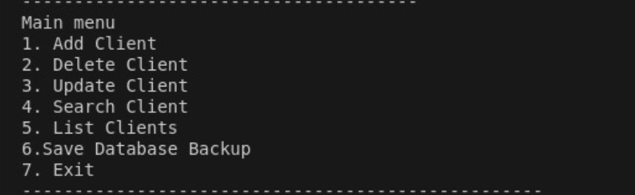
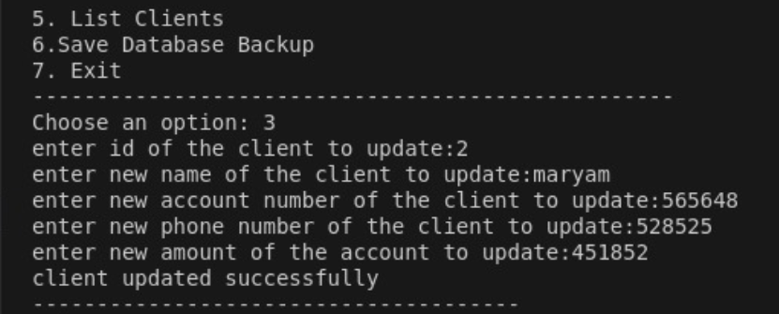
Update_client
Code
Output

Slide 12
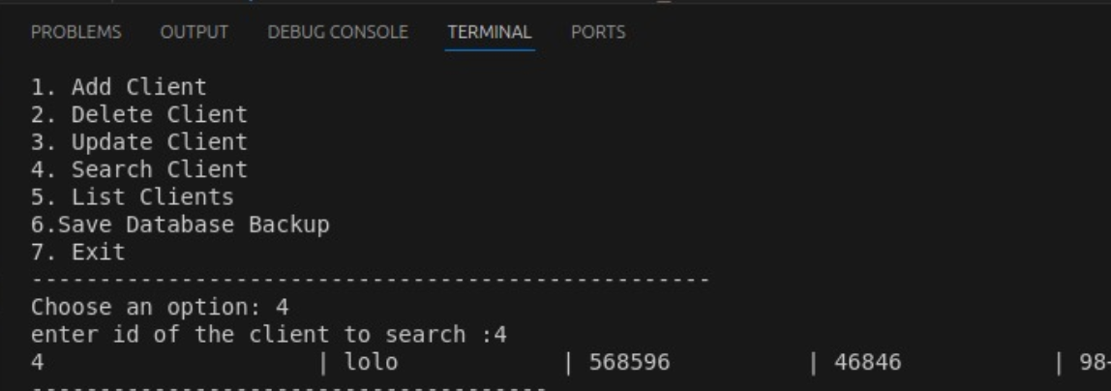
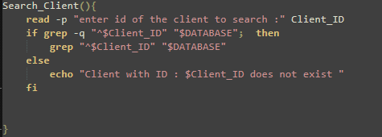
Search_client
Code
Output

Slide 13
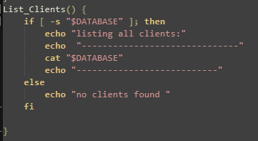
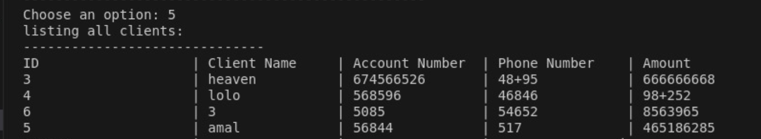
List_clients
Code
Output

Slide 14
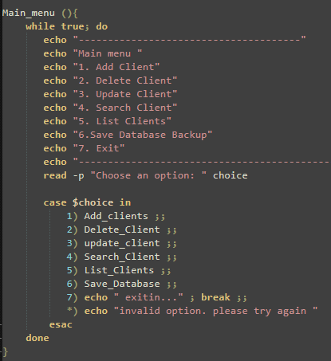
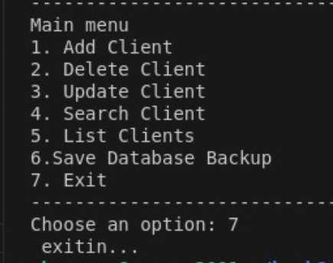
Main_menu
Code
Output

Slide 15
Challenges & Solutions
Challenges:
Handling duplicate IDs.
Handle the alignment of the database header
Handle the directory creation of the backup
Solution
Use grep for validation.
Using printf “ %10s ”
Get the current directory and edit permission

Slide 16
Deliverables
Initialize_db()
Ensures the database file exists.
Add_client()
Adds a new client with validation
Delete_client()
Removes a client by ID.
Update_client()
Updates client details.
Search_client()
Finds and displays client details.
Save_database()
Creates a backup.
list_clients()
Displays all clients.

Slide 17

Thank You
Hesitate to ask

